Slide 1

President’s Press Conference
CII Theme 2013-14
15 April 2013, New Delhi

Slide 2
State of the Economy
CII Theme 2013-14
2

Slide 3
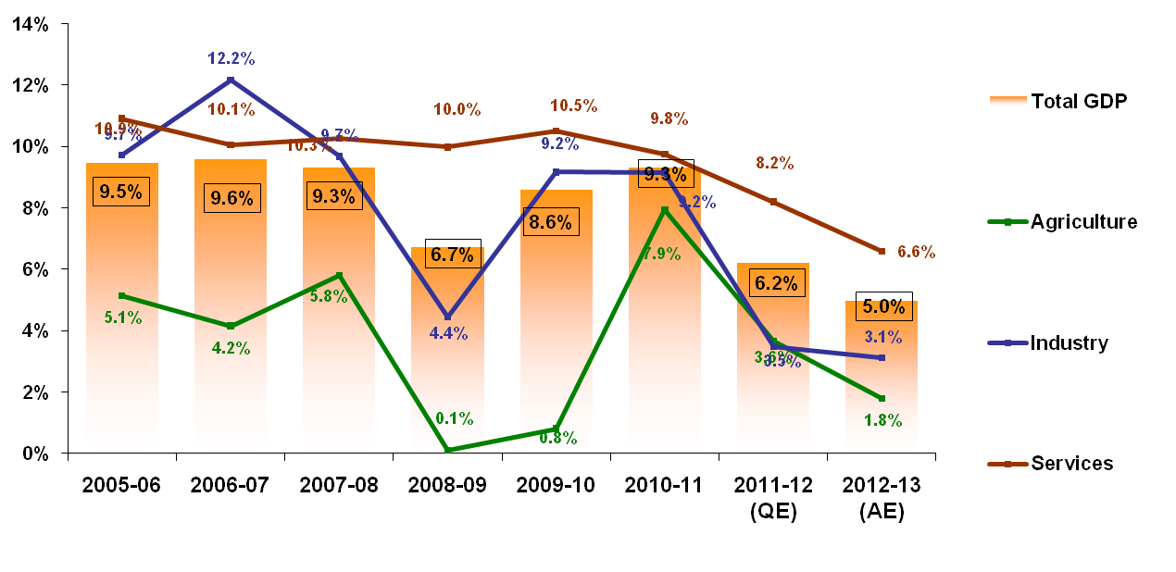
GDP growth at decadal low of 5.0%
GDP Growth (%)
Source: CSO, CII Research
© Confederation of Indian Industry
3
3
Notes:
First, I would like to talk a bit about the current economic situation.
GDP growth did not recover as expected and hit a decadal low of 5.0% in 2012-13
The growth rate for industry which includes mining, manufacturing, utilities and construction, at 3.1% is the key cause of concern. Manufacturing growth has plummeted to as low as 1.9%
Services too have moderated to a growth rate of 6.6% in line with the industrial slowdown

Slide 4
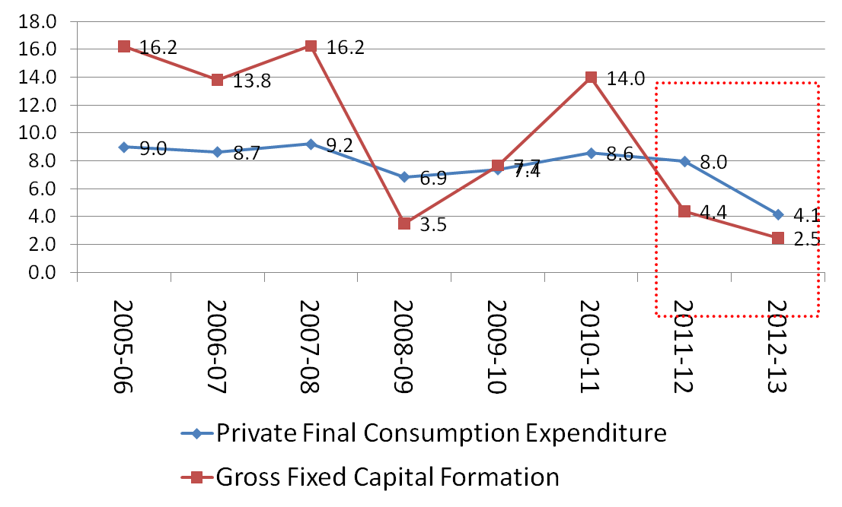
Consumption and Investment are both moderating
Annual Growth in Consumption and Fixed Investment
Source: CSO, CII Research
Calls for sharper reduction in interest rate
4
4
© Confederation of Indian Industry
Notes:
The investment-GDP ratio which had reached a peak of 38.1% in 2007-08 has moderated to 35.0% as of 2011-12
Consumption growth has also moderated for the first time in many years

Slide 5
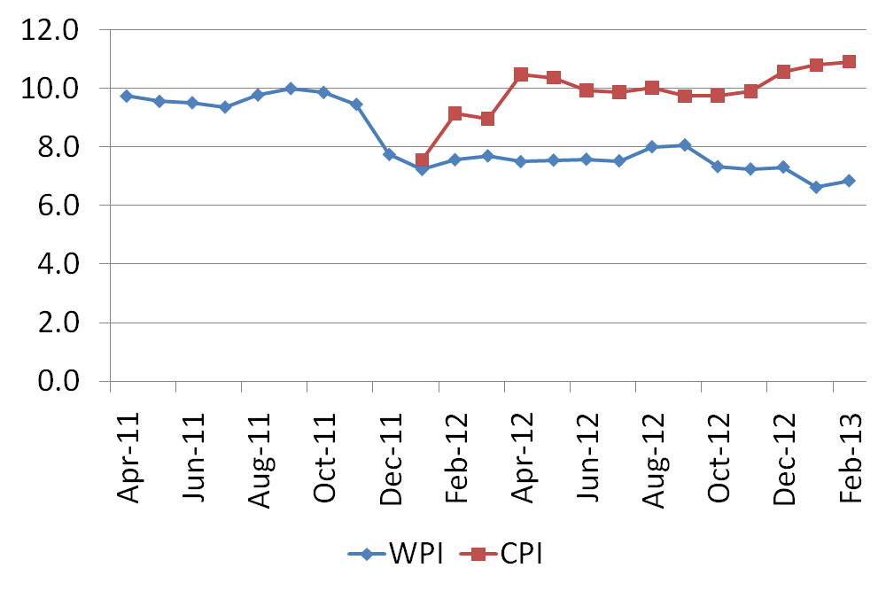
Divergent trends in WPI and CPI Inflation
WPI and CPI Inflation
Source: Office of Economic Advisor, CSO (CPI data is available starting January, 2012
De-bottlenecking Supply side essential
© Confederation of Indian Industry
5
5
Notes:
Although WPI inflation has moderated, CPI inflation remains high and food prices are a key threat
CII has maintained that supply side needs to be eased for inflation to be moderated; raising interest rates has been counter-productive as it has discouraged investment

Slide 6
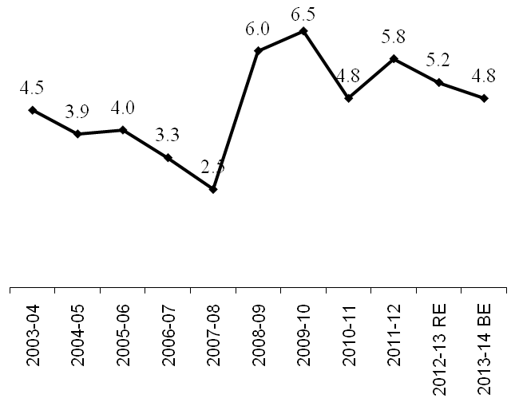
The Twin Deficits
Fiscal Deficit for 2012-13 stood at 5.2% of GDP, lower than the previous year’s level of 5.8%.
Budget 2013 has projected a decline in the deficit to 4.8% of GDP in 2013-14 and further to 3.0% by 2016-17.
The current account deficit is increasing, with the number already exceeding 5% of GDP in the first nine months of 2012-13 (Apr-Dec)
Fiscal deficit (as % of GDP)
Current Account deficit
 | 2010-11 (R) | 2011-12 (P) | 2012-13 (Apr-Dec) (P)
Current account Deficit (US$ Billion) | 48.1 | 78.2 | 72.0
As % of GDP | 2.9 | 4.2 | 5.4
Notes:
6
Fiscal consolidation will take place gradually over the next few years;
The challenge is to reduce the deficit without cutting capital spending which could have a negative impact on economic revival
Spending on subsidies will continue to remain high
The current account deficit has continued to increase due to declining exports even as imports on account of oil, gold and coal continue to rise
The current account deficit as a percentage of GDP at 5.4% during April to December 2012 is very worrying
It has made us dependent on capital inflows; even though capital inflows have been adequate till now, they could reverse at any time.
This would lead to currency depreciation and a depletion of our foreign exchange reserves.

Slide 7
Estimated GDP Growth
Fragile global recovery and tough domestic conditions have made it difficult to recover at a faster pace
 | 2011-12 (QE) | 2012-13 (AE) | 2013-14 (E)
Agriculture | 3.6 | 1.8 | 2.5 – 3.5
Industry | 3.5 | 3.1 | 5.0 – 5.5
Services | 8.2 | 6.6 | 7.2 – 7.5
GDP | 6.2 | 5.0 | 6.0 – 6.4
Source: CSO, CII Research
With the interest rate cycle turning, and the government making an effort to revive stalled projects, we can expect some recovery in 2013-14; depending on external developments, GDP growth could revive to 6.0-6.4%.
It would still be difficult to achieve an average growth rate of 8.0% in the 12th Plan period of 2012-13 to 2016-17.
However, 9% plus growth in the medium term possible
© Confederation of Indian Industry
7
7
Notes:
With the interest rate cycle turning, some recovery in capital formation and in GDP growth is likely in 2013-14
We expect a base case of 6.2% growth but it could range between 6.0 – 6.4%
Industrial growth is likely to recover given the low base of the previous year but not likely to grow more than 5.0 – 5.5%
Growth in the services sector will recover but not likely to accelerate beyond 7.2 – 7.5%, given the fragile global conditions
Agriculture will continue to grow at its average growth rate of 2.5 – 3.5%
Reviving the economy is an imperative, given that higher growth is required to meet aspirations of the people of India
Social programmes to achieve more inclusive growth can be sustained only if greater revenue is generated

Slide 8
Summing up - GDP Growth facing Headwinds
Growth in India moderated, significant contraction in manufacturing and mining segments
Slowdown in investment and consumption
Widening Current Account Deficit
  Volatility in global capital flows
CPI Inflation continues to be high
  Driven by rising food and fuel prices
Fiscal consolidation is key for reviving macro-economic balance
Growth to revive moderately in 2013-14
Hence, the major focus for the year 2013 is on . . .
© Confederation of Indian Industry
8
Notes:
Domestic conditions were challenging and prevented the recovery that was expected at the beginning of the year
Need to build resilience at home by restoring macro-economic balance viz. reducing the twin deficits
Also, we have ahead of us the Herculean task of reviving economic growth. This is essential to meet the aspirations of a billion plus and to make the transition to a developed nation which requires sustained high rates of equitable growth with development.
8

Slide 9
State of the Economy
CII Theme 2013-14
9

Slide 10
CII Theme 2013-14
Accelerating Economic Growth through Innovation, Transformation, Inclusion and Governance
10
10
Notes:
It is in this background that we have finalised the CII theme for 2013-14 as “Accelerating Economic Growth through Innovation, Transformation, Inclusion and Governance”

Slide 11
CII Theme 2013-14 Accelerating Economic Growth through Innovation, Transformation, Inclusion and Governance
ACCELERATE ECONOMIC GROWTH
REFORMS & GOVERNANCE
INCLUSIVE GROWTH & AFFIRMATIVE ACTION
INNOVATION ENTREPRENEURSHIP& GROWTH OF MSMEs
TRANSFORMATION OF SECTORS
GLOBAL ENGAGEMENT AND SUSTAINABILITY
11
11
Notes:
Under the CII theme we would focus on
Measures to accelerate economic growth
Four key enablers for Growth
Reforms and Governance
Inclusive Growth and Affirmative Action
Innovation, Entrepreneurship and Growth of MSMEs
Transformation of Sectors
We will also continue our focus on global engagement and sustainability

Slide 12
Accelerate Economic Growth
Aim for GDP growth rate of 8-9% in two years
  Invigorate investment & consumption demand
  Easy monetary policy
Revive stalled projects
  Cabinet Committee on Investment (CCI) should aim for making a
  repository of at least top 50 stalled projects and go for their revival on a priority basis
Improve ease of doing business
  Streamline procedural reforms
Notes:
As I have highlighted in the earlier slides too, it is important to lift the economic growth to 8-9% at the earliest.
One crucial ingredient for growth is kick starting investment and consumption demand. The Reserve Bank of India also needs to work in tandem with the Government in boosting growth by easing interest rates by at least 100 bps in the current fiscal.
Reviving stalled projects is a critical precursor for facilitating higher overall investment. While infrastructure investment has gained significant momentum over the last few years, the deficit continues to remain large. The Cabinet Committee on Investment (CCI) should aim for making a repository of the top 50 stalled projects in terms of the investment incurred and go for their revival on a priority basis.
India ranks at a low 132 amongst 185 global economies in terms of ease of doing business. This needs to change, if India has to catapult itself to the high growth trajectory. Streamlining procedural reforms is the first step in this direction and is critical.

Slide 13
Accelerate Economic Growth (contd..)
Increase investors confidence and increase investments
  Aim for fiscal consolidation
  Maintaining the momentum of Economic reforms
  Allow FDI in critical sectors such as Insurance, Banking etc
Increase start-up activity
  Announce measures to foster entrepreneur spirit
Create skilled workforce and capacity
  Facilitating greater participation of Private Sector companies in skill creation
Reforms and Governance imperative for accelerating economic growth
Notes:
There needs to be a special emphasis on increasing investor confidence so as to increase investments. For this, the momentum behind the recent government efforts on fiscal consolidation and economic reforms should continue.
While the government has recently opened up several new sectors to FDI, some crucial sectors such as Banking, Insurance still need to be opened up. FDI is the most stable form of capital flows and is required for financing our current account deficit.
Entrepreneurship needs to be encouraged and an ecosystem that facilitates more start-ups should be created.
Finally, India will also have to address the critical issues of creating jobs and preparing its youth to participate in its economic growth.

Slide 14
Reforms & Governance : Taxation Reforms
CII will …
  Work closely with the Empowered Committee of State Finance Ministers for the implementation of GST
GST
  CII hopes that the amended Constitutional Amendment Bill will be placed in the Parliament in the Monsoon Session 2013 after receipt of the recommendations of the Parliamentary Standing Committee on Finance
  CII will closely work with Central as well as State Governments for early introduction of GST
DTC
  CII will continue to advocate on issues that concern the industry
© Confederation of Indian Industry
14
14
Notes:
On the taxation front, there is a need for several key reforms starting with the implementation of GST. CII intends to work closely with the Empowered Committee of State Finance Ministers on this important issue.
We at CII are also hoping that the amended Constitutional Bill will be placed in the Parliament in the Monsoon Session 2013 after receipt of the recommendations of the Parliamentary Standing Committee on Finance.
In addition, we will also continue with our advocacy efforts on Direct Tax Code.

Slide 15
Reforms & Governance : State Reforms
Reform Priorities
  Distribution reforms in the Power Sector
  Incentivize implementation of Model APMC Act (de-notify Fruits, Vegetables, and other perishables from APMC list)
  Fast-track implementation of GST
  Land Reforms
  Procedural reforms for improving the Ease of Doing Business in India.
CII will…
  Policy advocacy on distribution reforms (implementation of Open Access and adoption of PPP Model)
  Policy advocacy on implementation of GST to get states on board.
CII Central Taskforce to Monitor State level Reforms
© Confederation of Indian Industry
15
15
Notes:
Some of the major reforms lie in the domain of the States. These second generation reforms are pivotal for revival of growth.
Some of the major State level reforms that CII will advocate are related to Agriculture, Power, Land acquisition and doing business reforms related to procedural issues and clearance issues faced in setting up new businesses.
We would continue our dialogue with the state governments on distribution reforms with a focus on Public Private Partnership models and reduction in Aggregate Technical & Commercial Losses
In the area of Agriculture, it is critical to incentivise the implementation of the Model APMC Act by denotifying fruits, vegetables and other perishables from the APMC list. I will discuss this in more detail when I talk about the issues in this sector.
States must also facilitate reforms on land such as long term land leasing of agricultural land for cultivation with farmers still retaining their ownership rights.
As I mentioned earlier, an important area of reform is GST. It is very important for all States to work towards early implementation of GST.
Another major issue faced at states’ level are related to approvals and clearances. Procedural reforms therefore become imperative to make it easier to do business in the states.
CII will therefore set up a Central Task Force to monitor State level Reforms

Slide 16
Reforms & Governance: Structural Reforms
Legislative inaction
Delays in Executive decisions
Agenda for action
Electoral reforms
Establish independent regulatory authorities in the following areas;
  Coal, real-estate, health etc.
  Principle - separate regulatory authorities dealing with Pricing, allocation, licensing & tariffs in areas such as power, telecom etc.
  Improve Centre-State discussion mechanism.
© Confederation of Indian Industry
16
16
Notes:
We have experienced in the recent past a slow down in legislative actions and executive decisions. This has also led to delays in project implementation which not only brings in investments into the economy but also creates demand for several products. For instance, implementing infrastructure projects in general could create demand for more than 100 plus industries.
Hence, the CII agenda for action this year will focus on some of the major areas of governance that would develop future decision making capacities, enable efficient functioning of markets especially in the resources sector and bring in efficacy of public expenditure.
CII has released its report on suggested electoral reforms. There is a need to implement and enforce immediately the recommendations of the Election Commission, Law Commission and judiciary in respect of candidate’s disqualifications at entry threshold. The government would do well to encourage serious candidates, fast track legal proceedings, revise asset disclosure norms, impose democracy cess for funding political parties, incentivize political funds, revise election expenditure limit, ensure transparency of accounts and hold elections simultaneously for both Parliament and State Assemblies.
Resources are scare and efficient allocation of resources is an absolute necessity. Hence having a regulatory structure for critical resources sectors would help with respect to pricing, allocation, licensing and tariffs.
CII will advocate for setting up of independent regulatory authorities in sector such as Coal, real estate, health etc. CII was happy to note the announcement of setting up of an independent regulatory authority for the Road sector in this year’s budget.
There is also a need to improve the mechanism of Centre-State discussions.

Slide 17
Reforms & Governance : Manufacturing
Issues
  Sector in the midst of slowdown – adequately confirmed by IIP data
  Investment having come down has impacted Additional Capacity creation
Reform Priorities
  Alignment of Manufacturing Plans at National and State level, implement National Manufacturing Policy
  Bring convergence on issues – Land Acquisition Bill, Minerals & Mining Regulation Bill, clearance of projects
  Streamlining business regulatory framework – ease transaction & compliance costs
Labour Reforms
  Facilitate industrial restructuring to help create employment
  Rationalization of Inspections
© Confederation of Indian Industry
17
Notes:
The manufacturing sector has been witnessing slow and declining growth. The cumulative growth between April 2012-January 2013 stood at 1.0% marking the sluggish growth momentum in the industry. The contraction in investment has impacted capacity creation in this sector
With changing global realities and rising uncertainties, the manufacturing sector will need to be the key driver of employment creation over the next decade, in contrast to current employment of only 12% of India’s working population.
It is clear that for the sector to regain its growth trajectory and become the engine for economic growth the reforms such as National Manufacturing Policy , aligning National and State manufacturing needs, simplifying business regulations, etc. need to be pushed and implemented without delay.
There is a need to ensure stakeholder convergence on two critical legislations, as the Land Acquisition and Rehabilitation and Resettlement Bill and the Mining and Minerals Development Regulation Amendment Act.
I would once again like to reiterate that the business regulatory framework needs to be streamlined to simplify the regulatory system, ensure fair competition among players and reduce the cost of compliance of doing business in the country.
Finally, the simplification of labour laws to facilitate industrial restructuring and rationalization of Inspections will also strengthen the growth momentum in this sector.

Slide 18
Reforms & Governance : Manufacturing (contd..)
CII will …
  Facilitate alignment of national and state priorities for manufacturing; create awareness and encourage NIMZs in resource endowed states
  Advocate for fast tracking delayed manufacturing projects
  Setup a Task Force to recommend a strategy to improve the business regulations in India
  Advocate for value addition and depth in select manufacturing sectors
  Create linkages/interaction between manufacturing sector and academia for attracting talent for manufacturing and encouraging R&D / innovation
  Advocate for creating a review mechanism for existing FTAs and due consideration to domestic industry concerns while signing new FTAs.
© Confederation of Indian Industry
18
Notes:
In the coming year, CII will work towards aligning the National and State priorities in manufacturing and creating awareness of the key policy interventions made in the National Manufacturing Policy. CII will work closely with government especially in the resource endowed states to establish new NIMZs.
CII will work closely with various government departments to ensure speedy approvals and clearances for large scale manufacturing projects. It is important for these projects to be implemented urgently to revive investment cycle. Here, I would like to suggest that the Cabinet Committee on Investments (CCI) could also consider reviewing projects below Rs 1000 Crores as well to boost investment and growth.
I propose to create a Task Force that will make recommendations for simplifying the regulations. These steps would also aim to improve India’s global position and overall ranking in terms of World Bank’s ‘Ease of Doing Business’ ranking.
Value-addition and depth is another important aspect that needs to be focused on. I would like to focus on key sectors such as electronics, chemicals etc as mentioned in the 12th Plan document.
For manufacturing growth, it is essential to have an ecosystem for R&D and innovation. Academic institutes play an important role in R&D and innovation. CII will work towards creating these linkages. These linkages would also help in attracting the right talent for manufacturing sector; which does not seems to be an attractive career option today.
FTAs is an important aspect in Indian trade but it is important to asses its impact on the domestic industry keeping in mind the actual intent of these FTAs. I would therefore like to propose a review mechanism to be created to review the existing FTA’s. This will be essential to asses the impact on domestic industry and suggest recommendations for amendments, wherever required.

Slide 19
Reforms & Governance : Agriculture
Mechanization of Indian Agriculture – Promote and expand mechanization through an inclusive approach (In line with the objective of the 12th FYP)
  Appropriate mechanization to ensure increase in farm productivity, savings on agri inputs (seeds, fertilizers, & labor)
  Custom hiring and adaptability to local needs to overcome the challenge of shrinking farm sizes
Role of Private Sector in Procurement, Storage & Distribution (PSD) of Grains
  Encourage private sector participation through clear long terms policies & not knee jerk responses by the government
  Create a policy dialogue between the private players & the government to better understand the issues related to PSD & together address the challenges in terms of rising food subsidy bill, & ensuring food security of the masses.
© Confederation of Indian Industry
19
19
Notes:
As articulated in the 12th Five Year Plan, mechanization will play a very important role in ensuring increase in farm productivity, and accelerating agricultural growth.
The approach will be to ensure appropriate mechanization that increases farm productivity, brings in savings on agri inputs (seeds, fertilizers, & labor).
Custom hiring and adaptability to local needs is therefore imperative to overcome the challenge of shrinking farm sizes
Given the food security complex in India, it is important to ensure that the country moves onto a better food grain management platform, giving the private sector an equal opportunity. Hence, the role of the private sector in procurement, storage & distribution of grains assumes significance.
To be able to take this agenda forward, it will be important to create a continuing policy dialogue between the private players & the government to better understand the issues and together address the challenges in terms of rising food subsidy bill, & ensuring food security of the masses.

Slide 20
Reforms & Governance : Infrastructure
Investment of $1 trillion envisaged during 2012-17 in developing infrastructure
Reform Priorities
  Set up “Independent PPP Commission” with authority and jurisdiction to renegotiate terms of contract
  Enable access to financing for projects
  Resolve Land Acquisition and Environmental Issues
  Institutionalize Effective Dispute Resolution Mechanism
  Address fuel (coal and gas) shortages in the Power Sector
  Accelerate Oil and Gas exploration and production in the country
CII will …
  Monitor Implementation & Advocacy for Infrastructure Projects of National Importance
  Advocate Uniform Regulatory Framework across Sectors to enhance investors’ confidence.
  Undertake advocacy for reforms in the coal and hydrocarbon sector to alleviate fuel shortages and enhance energy security
© Confederation of Indian Industry
20
20
Notes:
While PPP in the infrastructure sector has been a success story, there is an overarching feeling now that PPP is at crossroads with partnership being replaced by adversarial stance. CII has therefore made several recommendations in this regard especially for setting up an independent PPP Commission which has authority and jurisdiction to renegotiate the terms of the contract in the best interests of country.
Funding constraints are also impeding growth in the sector. It is critical to ensure that developers have access to low cost funding.
There is also a need to look at land acquisition, environmental and dispute resolution issues.
The Power sector has over the last few years been facing challenges on various fronts, the most critical one being acute fuel shortages which has led to the creation of stranded assets. The sector is also facing financing constraints as banks have reached their exposure limits.
Similarly, in the hydrocarbons space, the oil and gas exploration activity has slowed down considerably. This in conjunction with the coal shortages has led to increased reliance on imports to meet our energy needs and has adverse implications for energy security.
It is critical to take measures to accelerate oil and gas exploration in the country and provide Infrastructure status to this key sector.
CII has already constituted a Task Force on Infrastructure Monitoring & Advocacy to monitor the implementation of projects of national importance.
CII has advocated for the creation of a new Regulatory Architecture to enable "true” independence of functioning of sectoral regulators.
CII will also continue to advocate for coal sector and hydrocarbon sector reforms to alleviate fuel shortages and enhance the energy security of India.

Slide 21
Reforms & Governance : SMEs
Reform Priorities
  Revision of the definition / classification criteria for MSMEs
  Solutions to address ‘Delayed Payments’
  Enabling Policies to access Equity Capital
  Establishment of Central Climate Friendly Technology Fund and Branding/Export Marketing Fund
  Create Industrial Infrastructure
  Innovation led Entrepreneurial shift (in Defence, Aerospace etc)
CII will...
  Promote XBRL form of reporting, Factoring and Third Party receivables management system, to address ‘Delayed Payments’
  Facilitate the linkages of the Innovative Indian SMEs with the global supply chains of Foreign OEMs (in Defence, Aerospace etc)
  Promote Win-win partnerships between different stakeholders (SEBI/SE’s/VC’s/Angel investors/FIs/MFs etc) in the Equity capital domain for MSMEs
  Promote Transfer of Technology (TOT) on Defence Procurement/ Offset requirement for MSMEs.
© Confederation of Indian Industry
21
Notes:
21
With over 60% of CII membership from MSMEs, we provide a A+ priority to help facilitate their growth and development.
It is suggested that the compliance norms for the MSMEs may be based on the similar classification criteria, as specified by the Ministry of Micro, Small and Medium Enterprises.
To mitigate the problem arising out of delayed payments, CII proposes leveraging the Extensible Business Reporting Language (XBRL) format of reporting for tracking payments to MSMEs and an effective use of the Factoring and Third Party Receivables Management.
It is recommended that the large industry that are purchasing from MSMEs, may be entitled to avail a tax benefit, subject to the transaction having been completed (including timely payment to the SME supplier).
A Central Climate Friendly Technology Fund needs to be set up to help MSMEs adopt Climate Friendly technologies to enhance the self-reliance on energy and also be responsible towards the environment.
With a view to address the availability of Industrial Infrastructure, a corporation/SPV needs to be created which will hold the industrial land/building under its ownership. The MSMEs will use the facilities paying rent/service charges for initial 7-10 years.

Slide 22
Enablers for Accelerating Economic Growth
CII Theme 2013-14 : Focus Areas
  Inclusive growth and Affirmative action
  Innovation, Entrepreneurship and Growth of MSMEs
  Transformation of Sectors
© Confederation of Indian Industry

Slide 23
Inclusive Growth & Affirmative Action: Inclusive Growth
Objective: Inclusion of marginalised people, SC/STs, women, disabled, informal workforce & backward geographies
Key Thrust Areas
  Access to opportunities for livelihood creation (education, skill development, rural entrepreneurship)
  Affordable access to healthcare (disease prevention and healthcare services)
  Grass-root level development (mainstreaming backward areas)
Action Plan
  Advocacy on development issues with members and the government
  Catalyse structured CSR initiatives by corporates
  Work with Government and multilateral institutions to strategically align development initiatives with UN’s Millennium Development Goals
© Confederation of Indian Industry
23
Notes:
Inclusion has been one of the key pillars of CII. This has taken shape in the form of CII interventions towards upliftment of marginalized people, SC/STs, women, disabled, informal workforce & backward geographies
The Key Thrust Areas towards this have been access to opportunities for livelihood creation with a focus on education, skill development, rural entrepreneurship; Affordable access to healthcare which includes disease prevention and healthcare services; and Grass root level development and mainstreaming backward areas.
Towards achieving these developmental objectives, CII has undertaken initiatives in the form of engaging in advocacy on development issues with members and the government; catalyzing structured CSR initiatives by corporates and working with the Government and multilateral institutions to strategically align development initiatives with UN’s Millennium Development Goals.

Slide 24
Inclusive Growth & Affirmative Action: Skills Development
Key Focus Areas:
  Capacity building while ensuring quality
  Sustainable skill development programmes
  Independent assessment and evaluation
  Focus on employability
  Global benchmarking
CII Initiatives 2013-14:
  Handhold 16 under-performing ITIs (4 in each Region)
  12 Trainings of Trainer programmes with International Partners and State Governments
  Pilot on recommendations in the Apprenticeship Bill
  Facilitation of 3 Sector Skill Councils and 4 Skill Hubs to be set up
  17 CII-PanIIT Skill Gurukuls to be set up
  Fielding candidates for WorldSkills International Competitions
© Confederation of Indian Industry
24
Notes:
CII pioneered the skill development movement well recognising the fact that with limited natural resources and a burgeoning population, India’s principal resource is its people.
CII adopted a set of guiding principles for its skills initiative:
Capacity building while ensuring quality
Sustainable Skill development programmes
Independent Assessment and evaluation
Focus on employability
Global Benchmarking
CII Skill Development initiatives have highlighted private sector engagement.
In 2013-14 CII will:
Handhold 16 under-performing ITIs (4 in each Region). (Out of the 390 Industrial Training Institutes (ITIs) adopted by CII members since 2007; CII members adopted 30 ITIs in 2012-13.)
12 Training of Trainer programmes with International Partners and State Governments
Pilot on recommendations by CII on amendments in the Apprenticeship Bill
Facilitation of Sector Skill Councils in Beauty & Wellness, Manufacturing & Chemicals (We have already facilitated the formation of Sector Skill Councils in the areas of Healthcare; Banking & Financial Services & Insurance (BFSI); Logistics and Life Sciences)
4 Skill Hubs to be set up in Keonjhar (Odisha), North East (Digboi), Chennai and UP (3 Skill Hubs in Chhindwara (MP), Balasore (Odisha) and Bhiwadi (Rajasthan) are already operational)
17 CII-PanIIT Gurukuls to be set up in 2013-14 (13 Skill Gurukuls are functioning in the States of Chattisgarh, Rajasthan, Bihar, Jharkhand, Maharashtra and Tamil Nadu)
Fielding candidates for the WorldSkills International Competitions 2013, Lleipzig, Germany in five trades of (i) Mechatronics (ii) Welding (iii) Electronics (iv) CNC Turning (v) CNC Milling

Slide 25
Inclusive Growth & Affirmative Action: Affirmative Action
Education
  Focus on Education for SC/ST candidates and marginalized sections with Scholarships in higher education to be increased
Skills and Vocational training
  Interventions planned in 4 SC/ST dominated districts
  CII in partnership with PanIIT Reach for India (PARFI) to set up Skill Gurukuls in SC/ST dominated locations.
Entrepreneurship and Supplier Diversity
  10 supplier diversity meets planned this year. Objective to mobilize business transactions between Dalit entrepreneurs and CII members and mentor SC/ST entrepreneurs
Employment
  Targeted efforts through job fairs for SC/ST
  Linking industry with job seekers from marginalized sections through job portal www.thefairjob.com
© Confederation of Indian Industry
25
25
Notes:
CII has been actively pursuing an Affirmative Action Agenda since 2006. The Industry is taking measures to encourage Affirmative Action for the SC/STs through varied models
CII is working on 4Es – Education, Employability, Entrepreneurship and Employment to ensure all round inclusion of marginalized sections in to economic mainstream.
There is a strong focus on education for SC/ST candidates. In 2012-13, CII and its member companies granted 32000+ scholarships to these candidates. This year we plan to focus on offering scholarships to SC/ST youth in secondary education as well while we continue to grant scholarships in higher education with increased vigour.
In the area of skill development and vocational training, more than 41,000 SC/ST candidates were trained in the year 2012-13. Skill development training programmes have been initiated in two adopted districts, Nawanshahr and Cooch Behar, in the area of retail and hospitality.
In another major initiative, CII & Pan IIT Alumni, in joint collaboration, are setting up the Skill Training Centres on a residential Gurukul model. The Skill gurukuls are predominantly in SC/ST dominated locations. 13 Gurukuls are already operational in Gumla & Jamshedpur (Jharkhand); Purnia (Bihar); Purulia (WB); etc. We also intend to increase the percentage of SC/ST candidates in several skill Development projects of CII and its members
To encourage entrepreneurship in marginalized sections, CII plans to increase the supplier diversity meets in all Regions with the aim to increase business transactions between CII members and Dalit entrepreneurs.
This will also help to mentor and build networks for SC/ST entrepreneurs to enable them to leverage existing opportunities and simultaneously train and develop new entrepreneurs.
On the employment front, CII is assisting its member companies to reflect greater representation of SC & ST in new recruitment at all levels. This year targeted efforts to place SC/ST candidates with CII members through job fairs are planned.
Also efforts are on to popularize recently launched job portal www.thefairjob.com jointly with NACDOR linking industry with job seekers from marginalized sections

Slide 26
INNOVATION AND ENTREPRENEURSHIP
Increase industry investment in R&D and design
    Enabling policy and incentives including benchmarking and sharing best practices in the states
    Industrial Innovation Framework: A CII tool to measure industry’s innovation readiness
    Risk financing through “Global Innovation and Technology Alliance”
Increase Industry-Academia Collaborations
    Industry awards for top industry-linked academic institutions
    PPP fellowship for doctoral research at Universities through CII Government schemes
Notes:
Industry investment in R&D, Innovation and Design needs to increase significantly. Currently, Indian industry’s investment in R&D is very low (around 0.3% of GDP) compared to many nations including China. Government wants to put many stimulants to raise it to 1% of GDP in 12th Five year Plan. Therefore there is a need to have an enabling policy framework to encourage investments in innovation and design.
For instilling innovation in the DNA of a company, CII has developed a framework, the Industrial Innovation Framework, which measures an industry’s innovation readiness. It primarily establishes a process by integrating innovation into business strategy, developing internal innovation champions, maximizing competitiveness and market leadership and enhancing the portfolio of new products and processes and services.
For investing in R&D, the industry can also tap Global Innovation and Technology Alliance (GITA), a joint venture between the Government and CII, which extends financial support in the form of soft loans/grant for R&D projects
In addition, Industry-Academia linkages also need to be enhanced. CII in partnership with the All India Council of Technical Education (AICTE) has developed a framework to measure institute’s linkages with industry. CII intends to garner support from industry to sponsor cash awards for institutions which have strong industry linkages.
Moreover, to enable talented students to pursue PhD in industrial research, CII in partnership with the Department of Science & Technology has created a vehicle, the Prime Minister’s Fellowship Scheme, for Doctoral Research in which PhD scholars will get double scholarships co-sponsored by DST and CII member companies. The Prime Minister conferred the first set of scholarships in January this year.
26

Slide 27
INNOVATION AND ENTREPRENEURSHIP (contd..)
Increase Number of intellectual Property Owners in India
  Awareness, capacity development and protection through CIIs PPP Centers/Cells in the states
  Balanced IP Ecosystem benefitting industry and society
Increase number of Start –ups
  Scouting, mentoring, incubating and supporting start-ups
  “India Start-ups” group in CII
Notes:
The number of Patents filed by Indian companies in India is around 15-20% of the total filing. We need to improve this. The gap areas are awareness and capacity to manage IP.
CII in partnership with state Governments and Ministry of MSME established Technology centers and IP Facilitation cells in Andhra Pradesh, Tamil Nadu, Gujarat, Madhya Pradesh and Karnataka such centers and cells to help MSMEs and entrepreneurs protecting IP.
We are also working with the government both at the centre and state level to build a robust IP ecosystem covering protection, exploitation and enforcements of IP benefitting business and society.
Entrepreneurs and Start-ups are the future businesses of India. We need to support them. CII in partnership with the Government and member companies run a program called “India Innovation Initiative” where innovations are scouted and connected to industry, incubators and Angel/VC funding agencies to mature them.
We are planning to create a platform for Indian Start-ups in CII to support them.
27

Slide 28
TRANSFORMATION OF SECTORS
Job creation potential across sectors
    Project Village Budha – to implement 100 Kaizens in village environment this year and help in employment creation
Job creation potential across Manufacturing Sector
    Visionary Leaders for Manufacturing Programme – to take the number of visionary Leaders to 1000 this year and evolve into a new programme called “The Champions of Societal Manufacturing”
Special program for MSMEs
    Golden Top 100 SMEs - selecting and handholding 50 SMEs in next two years to enable the SMEs contribution to GDP.
    1000 SME programme : Success amongst 230 SMEs – scaling to 1000 SMEs in 3 years.
Notes:
Transformation is another key enabler for economic growth.
This year, we would be starting a three year project called Project Village Budha which would be targeting to take the idea of Kaizens (small improvements) and enable implementation in a village environment. The objective would be to help earning power of people in the villages through a structured programme for large, medium and small companies from all sectors. This year we would pilot the programme in target villages. Next year we would develop the programme for developing Business champions for the societal sector in big companies.
The Visionary Leaders for Manufacturing Programme would reach out and cross the 1000 mark this year. This is at 887 presently. The programme is creating a transformation of more than 100 Manufacturing companies.
Golden Top 100 SMEs is a new programme which would be designed along the lines of the Malaysian SME corporation programme targeting selection of seriously committed SMEs and take them through a structured programme to help them become contributors to Indian SME growth.
The 1000 SME project would aim to develop a Win-Win Relationship amongst OEMs and their Tier 1 and Tier 2 companies. The project has already realised more than 230 companies through the unique programme called Visionary SME programme. This is now being scaled up to take the number to cross 1000 in next three years. This programme is held under the India-Japan Technical cooperation programme.
28

Slide 29
TRANSFORMATION: India@75
Core for India to be a developed nation and global leader by 2022
Interventions in
  Skills – Skillpedia, Power To Empower, aggregation of skills in India
  Urbanization – City Connect , Indexing of cities
  Volunteering and Pro-Bono
  India Backbone Implementation Network (IBIN)
  PhD at Macquarie University
Notes:
CII has been supporting a national vision that seeks to see India a developed nation in global leadership role by 2022. To achieve this vision, CII has worked on some key interventions in areas including skill development, urbanisation, creation of a Backbone Implementation Network. This would now be a part of our Transformation Agenda.
In the area of skills, CII has developed skillpedia an IT platform to bridge the demand supply gap of skills besides being the one stop shop for skills. We have also organised Skills business plan competition jointly with the National Skill Development Council for the last 2 years to sensitize the youth on the business opportunity in this sector.
In urbanization I have personally been involved in creation of City Connect Platforms in cities across India to provide an autonomous platform for local citizenry, to collaborate and participate in planned and systematic urbanization of their respective cities. We are also working on indexing of approximately 441 class I Indian cities on 12 parameters. The indexing is intended to create traction for participative development with provision of gap analysis and technology driven solutions.
Then there is a Pro-Bono program which aims to leverage the business talents of professionals and corporations in India to work with non profit organizations on areas that can help improve their internal capacity and organizational functioning.
CII through its India@75 initiative will also be working with the Planning Commission on India Backbone Implementation Network (IBIN) for generating consensus amongst diverse stakeholders. IBIN will also work on bridging the gaps identified by various agencies in the delivery system; thus endeavoring to improve efficiency of the implementation process.
We have also connected up with Macquarie university which has committed 11 million AUD for grant of PhD scholarship to 55 scholars who will undertake research in areas aligned with the vision.
29

Slide 30
Focus: Sustainability
Given the high ecological foot print and the dependence on Oil, there is an urgent need to deepen the sustainability initiative.
CII Will…
  Promote Green Companies through GreenCo Rating
  Promote Green Cities, Homes, Factories, Landscaping, etc.
  Facilitate access to reliable and clean energy through Green Power Market Development Group (GPMDG)
  Promote use of renewables to power telecom towers (SPEED)
  Undertake Carbon Footprint Study for different States and recommend measures for a low carbon growth trajectory
  Launch Leaders for Nature (LFN) in India with International Union for Conservation of Nature (IUCN)
  Develop a Sustainability Label for companies which will allows consumer to reward sustainability champions.
CII Campaign for Green Companies
30
Notes:
Sustainability has become a cornerstone for India’s development given the challenges of a growing population, climate change and lack of infrastructure.
Some key initiatives in this space that we have taken include the launch of GreenCo rating, the first of its kind in the world. GreenCo rates companies on the environmental friendliness of their activities & products and suggests the way forward in pursuing a Green path. About six companies have been rated and more than 50 companies are working on this Rating
CII is spearheading the green building movement in India. Today, India has over 1,980 registered green building projects amounting to over 1.38 Billion sq.ft of green building footprint. There is also a need to focus on promoting Green Cities, Green Homes, Green Landscaping, Green Existing Buildings, etc..
CII and World Resources Institute (WRI) have launched India’s first Green Power Market Development Group (GPMDG) to scale-up Indian Green Energy markets and enabling corporate buyers to access reliable and clean energy, and diversify their energy portfolios with Green Power.
Another initiative, Project SPEED, aims to provide affordable green energy to rural India with mobile towers serving as anchor loads. Under this initiative, more than 50 commercial pilots will be set up in the country in the next two years.
In 2012, CII has released a Report on Tamil Nadu's Carbon Footprint. This Report has estimated the baseline emissions for Tamil Nadu in 2009-10 and has highlighted broad opportunities for emission reduction. This year, CII would undertake similar studies in other States including Andhra Pradesh, Odisha and West Bengal.
Business has a key role in conservation and CII in partnership with the International Union for Conservation of Nature (IUCN) will be launching Leaders for Nature network in India.
CII also intends to launch a Sustainability label which will provide consumers information on the sustainability performance of a company.

Slide 31
Focus: Global Engagement
Priorities
  Widen focus on boosting exports to new emerging markets like Latin American, ASEAN , Africa and CIS countries; reduce trade deficit with China
  FTAs: Help industry to make use of existing FTAs to their advantage and integrate into the regional/global value chain
CII will…
  focus on key areas for global engagement – sourcing of raw materials, energy & food security, external trade enhancement
  Deepening engagement with South Asia, South East Asia, Gulf and Africa
  Continue Strategic Dialogues: US, Israel, Japan and Singapore
  Deepen Multilateral engagement: ADB, B-20, BIMSTEC, BRICS, IBSA, OECD, WTO, World Bank
  High powered CEO delegation visits to focus Countries – Angola, Bangladesh, Canada, China , D R Congo, Japan, Pakistan , Russia, Singapore, Sri Lanka, Tanzania, UK, US
© Confederation of Indian Industry
31
Notes:
On the global front CII undertakes activities to connect Indian business with global business, policy makers and other relevant stakeholders
To address the issue of widening Current Account Deficit, CII along with the Government of India will work on a three pronged strategy comprising export promotion particularly to emerging markets like Latin America, ASEAn, Africa and CIS countries; strengthening the import competing sector through greater focus on manufacturing and FDI inflow.
CII will also help industry to make use of existing FTAs to their advantage and integrate into the regional / global value chain.
We intend to focus on the key areas of sourcing raw materials, energy & food security and external trade enhancement.
During the year, we will deepen its engagement with the emerging markets of South East Asia, Latin America and Africa. Revive engagement with traditional markets
Mutli-lateral FORA are important for enhancing India’s international relations. Hence, CII will engage more effectively with ADB, B-20, Organisation for Economic Cooperation and Development (OECD), Bangladesh, India, Myanmar Sri Lanka, Thailand Economic Cooperation (BIMSTEC), Brazil Russia India China and South Africa (BRICS), India Brazil South Africa (IBSA), World Bank, WTO

Slide 32
To Sum Up
CII for easier monetary policy-reasonable credit cost and adequate liquidity in the market
CII will set up a Task Force to recommend strategies to improve business regulations in India
CII will monitor implementation & undertake advocacy for Infrastructure Projects of National Importance
CII will continue policy advocacy on implementation of GST
CII will continue to engage with the Government and Political parties on FDI in critical sectors (insurance and pension funds)
CII will set up a Central Task Force to monitor State Reforms
CII will help transform 100 SMEs ( 25 in each region) to mid-size and large companies
CII will launch a campaign for Green Companies
CII will set up 3 Sector Skill Councils, 4 Skill Hubs and 17 CII-PanIIT Skill Gurukuls
32

Slide 33
Thank You
© Confederation of Indian Industry
33
33

